Slide 1
Common-Mode fundamentals for Shipboard Power Systems Part 3 Common Mode Modeling CM Voltage Source
Dr. Norbert Doerry Dr. John Amy
http://doerry.org/norbert/MarineElectricalPowerSystems/index.htm
© 2025 by Norbert Doerry and John Amy This work is licensed via: CC BY 4.0 (https://creativecommons.org/)

Slide 2
Common Mode Lumped Parameter circuit model
Goal is to create a simplified circuit model that only models the impact of CM currents.
Gain an understanding of where CM currents will flow.
Gain an understanding of the magnitude of CM currents and voltage.
Gain an understanding of what mitigation methods are likely to be successful or not.
Asymmetry in the DM-CM mixed model links the DM and CM models.
If the phase currents are much greater than the CM currents, the linkage may often be assumed to be one way from the DM model to the CM model.

Slide 3
Neutral Voltage vs Neutral Conductor
Neutral Voltage is used in CM modelling
Average value of the instantaneous voltages of a set of conductors with respect to a common point.
Often, a specific conductor may be designated a “neutral”
The “grounded” conductor in a single-phase 120 VAC system
Black Conductor is at 120 VAC with respect to ground
White Conductor (called the neutral conductor) is at 0 VAC with respect to ground
Not at the neutral voltage
Neutral Voltage with respect to ground is 60 VAC (Black and White Conductors)
The “grounded” conductor in a split 240 VAC system
Black Conductor is at 120 VAC with respect to ground
Red Conductor is at -120 VAC with respect to ground
White Conductor (called the neutral conductor) is at 0 VAC with respect to ground
Should be very close to the neutral voltage
Neutral Voltage with respect to ground is 0 VAC (Black, Red, White conductors)
For a three-phase wye-connected source, conductors connected the wye point are often called neutral conductors for the three phase conductors.
If the voltages do not have triple-n harmonics, the wye point voltage should be close to the neutral voltage.
If triple-n voltage harmonics are present, then the wye point voltage will not be at the neutral voltage.

Slide 4
Sources of Common Mode Voltages
Power Electronics
See Parts 2 and 5
Ground Fault
Asymmetry
Grounding method
Multiple Current Paths

Slide 5
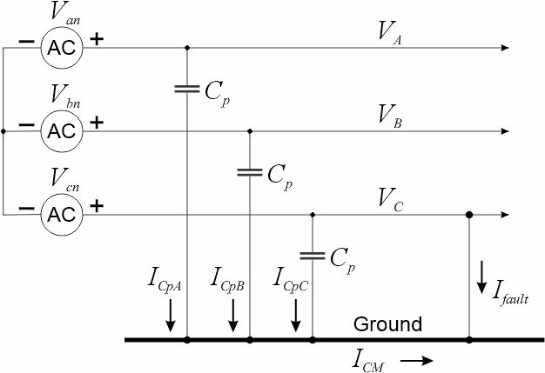
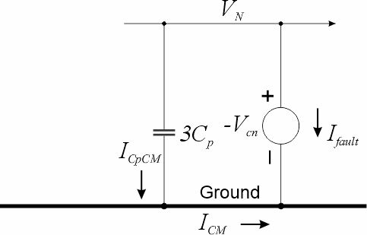
Ground Fault
A ground fault can be modelled as a voltage source equal to the negative of the faulted phase voltage to neutral voltage.
$$I_{CpCM}=−\hat{j}ω3C_{p}V_{cn}$$
$$\left|I_{fault}\right|=3ωC_{p}V_{line_to_neutral}$$
$$\left|I_{fault}\right|=\sqrt{3}{ωC}_{p}V_{line_to_line}$$

Slide 6
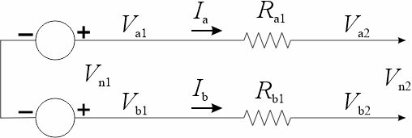
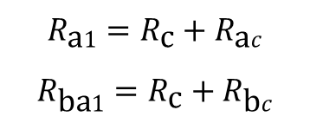
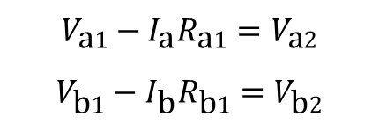
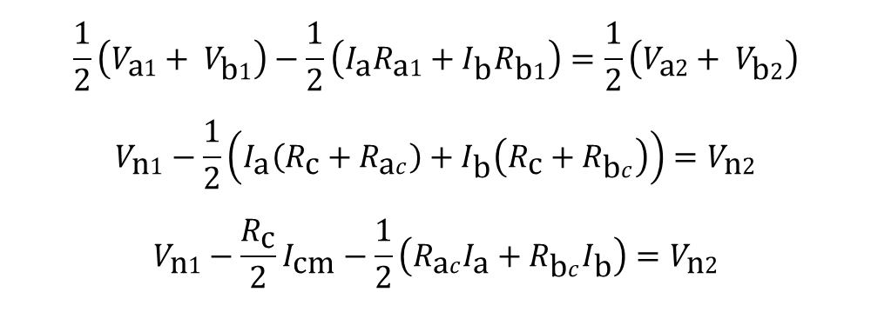
Asymmetry
$$V_{\text{a}1}−I_{\text{a}}R_{\text{a}1}=V_{\text{a}2}$$
$$V_{\text{b}1}−I_{\text{b}}R_{\text{b}1}=V_{\text{b}2}$$
Break up the resistances into two parts
$$R_{\text{a}1}=R_{\text{c}}+R_{\text{a}c}$$
$$R_{\text{ba}1}=R_{\text{c}}+R_{\text{b}c}$$
Develop CM Model
$$\frac{1}{2}\left(V_{\text{a}1}+ V_{\text{b}1}\right)−\frac{1}{2}\left(I_{\text{a}}R_{\text{a}1}+I_{\text{b}}R_{\text{b}1}\right)=\frac{1}{2}\left(V_{\text{a}2}+ V_{\text{b}2}\right)$$
$$V_{\text{n}1}−\frac{1}{2}\left(I_{\text{a}}\left(R_{\text{c}}+R_{\text{a}c}\right)+I_{\text{b}}\left(R_{\text{c}}+R_{\text{b}c}\right)\right)=V_{\text{n}2}$$
$$V_{\text{n}1}−\frac{R_{\text{c}}}{2}I_{\text{cm}}−\frac{1}{2}\left(R_{\text{a}c}I_{\text{a}}+R_{\text{b}c}I_{\text{b}}\right)=V_{\text{n}2}$$
Linkage to DM model

Slide 7
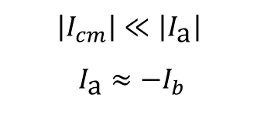
Asymmetry
If we choose …
$R_{\text{c}}=\frac{1}{2}\left({ R}_{\text{a}1}+ R_{\text{b}1}\right)$
$$R_{\text{a}c}{=R}_{\text{a}1}−\frac{1}{2}\left({ R}_{\text{a}1}+ R_{\text{b}1}\right)=\frac{1}{2}\left({ R}_{\text{a}1}− R_{\text{b}1}\right)$$
$$R_{\text{b}c}=R_{\text{b}\text{1}}−\frac{1}{2}\left({ R}_{\text{a}1}+ R_{\text{b}1}\right)=\frac{1}{2}\left({ R}_{\text{b}1}− R_{\text{a}1}\right)= −R_{\text{a}c}$$
If the CM current is much less than the phase current
$$\left|I_{cm}\right|≪\left|I_{\text{a}}\right|$$
$$I_{\text{a}}≈−I_{b}$$
With this assumption and choice of $R_{\text{c}}$ the cm model becomes
Linkage to DM model
Linkage to DM model

Slide 8
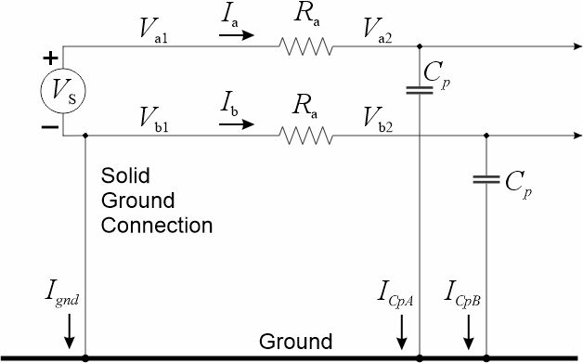

Grounding Method
$$V_{\text{b}\text{1}}=0$$
$$I_{\text{b}}=0$$
$$V_{cm}=\frac{1}{2}V_{S}=\frac{1}{2}V_{\text{a}1}=V_{\text{n}1}$$
$$I_{cm}=I_{\text{a}}$$
$$I_{cm}=I_{\text{a}}=\frac{V_{S}}{R_{\text{a}}−\frac{\hat{j}}{ωC_{p}}}=\frac{V_{\text{cm}}}{\frac{R_{\text{a}}}{2}−\frac{\hat{j}}{ω{2C}_{p}}}$$
Grounding one conductor results in a CM voltage source
Grounding at the neutral eliminates CM voltage source

Slide 9
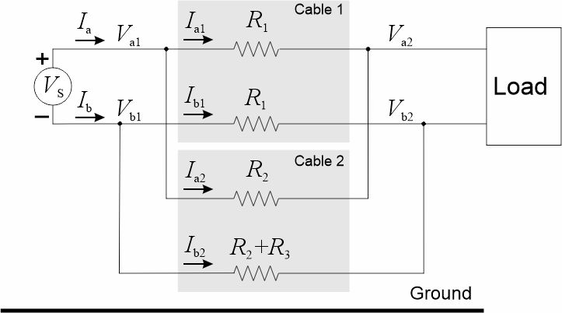
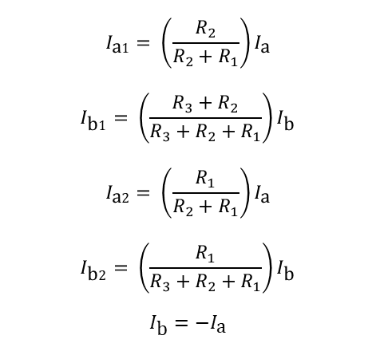


Multiple Current Paths – Ring Bus
$$I_{\text{a}1}= \left(\frac{R_{2}}{R_{2}+R_{1}}\right)I_{\text{a}}$$
$$I_{\text{b}1}= \left(\frac{{R_{3}+R}_{2}}{{R_{3}+R}_{2}+R_{1}}\right)I_{\text{b}}$$
$$I_{\text{a}2}= \left(\frac{R_{1}}{R_{2}+R_{1}}\right)I_{\text{a}}$$
$$I_{\text{b}2}= \left(\frac{R_{1}}{{R_{3}+R}_{2}+R_{1}}\right)I_{\text{b}}$$
$$I_{\text{b}}=−I_{\text{a}}$$
$$I_{\text{cm}\text{1}}=\left(\frac{R_{2}}{R_{2}+R_{1}}\right)I_{\text{a}}−\left(\frac{{R_{3}+R}_{2}}{{R_{3}+R}_{2}+R_{1}}\right)I_{\text{a}}$$
$$I_{\text{cm}\text{1}}=\left(\frac{\left({R_{3}+R}_{2}+R_{1}\right)R_{2}−\left({R_{3}+R}_{2}\right)\left(R_{2}+R_{1}\right)}{\left({R_{3}+R}_{2}+R_{1}\right)\left(R_{2}+R_{1}\right)}\right)I_{\text{a}}$$
$$I_{\text{cm}\text{1}}=\left(\frac{−R_{3}R_{1}}{\left({R_{3}+R}_{2}+R_{1}\right)\left(R_{2}+R_{1}\right)}\right)I_{\text{a}}$$
$$I_{\text{cm}\text{2}}=\left(\frac{R_{1}}{R_{2}+R_{1}}\right)I_{\text{a}}−\left(\frac{R_{1}}{{R_{3}+R}_{2}+R_{1}}\right)I_{\text{a}}$$
$$I_{\text{cm}\text{2}}=\left(\frac{\left({R_{3}+R}_{2}+R_{1}\right)R_{1}−R_{1}\left(R_{2}+R_{1}\right)}{\left(R_{2}+R_{1}\right)\left({R_{3}+R}_{2}+R_{1}\right)}\right)I_{\text{a}}$$
$$I_{\text{cm}\text{2}}=\left(\frac{R_{3}R_{1}}{\left(R_{2}+R_{1}\right)\left({R_{3}+R}_{2}+R_{1}\right)}\right)I_{\text{a}}$$
If one of the paths has conductors with different impedances, each path will have a common mode current (equal and opposite). The CM current “circulates” around the “ring.” While this CM current does not go through the ship’s hull, it can be a source of EMI.
$$I_{\text{cm}\text{1}}=I_{\text{a}1}+I_{\text{b}\text{1}}$$
$$I_{\text{cm}\text{2}}=I_{\text{a}2}+I_{\text{b}\text{2}}$$

Slide 10
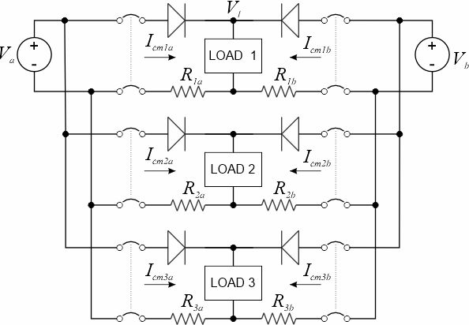
Multiple Current Paths – Common Return
The voltage source with the higher voltage supplies power to the load. While the supply path is direct through the “auctioneering diode”, multiple return paths through the common negative bus result in a common mode current flow in all the cables.
While this CM current does not flow through the ship’s hull, it may be a source of EMI.

Slide 11
Wrap up

